Slide 1
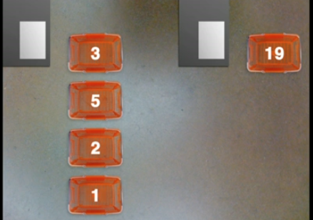
Factorising Expressions
Date: Tuesday 25th February 2014
LO: To be able to factorise expressions into single brackets (Level 5c)
STARTER:
Here is a checkout queue in Sainsbury's. Which line do you join? Why?

Slide 2
What is the highest common factor of .....
10 and 15
2
10
A)
B)
5
3
C)
D)

Slide 3
What is the highest common factor of .....
9 and 12
4
3
A)
B)
9
1
C)
D)

Slide 4
What is the highest common factor of .....
15 and 20
4
3
A)
B)
10
5
C)
D)

Slide 5
What is the highest common factor of .....
18 and 30
6
9
A)
B)
2
3
C)
D)

Slide 6
What is the highest common factor of .....
16 and 24
4
16
A)
B)
12
8
C)
D)

Slide 7
What is the highest common factor of .....
12 and 36
9
12
A)
B)
8
4
C)
D)

Slide 8
What is the highest common factor of .....
20 and 30
6
10
A)
B)
4
5
C)
D)

Slide 9
What is the highest common factor of .....
28 and 70
4
7
A)
B)
10
14
C)
D)

Slide 10


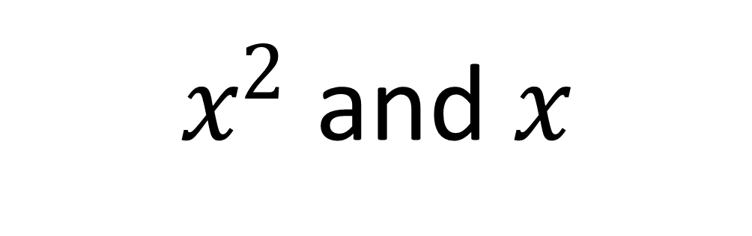
What is the highest common factor of .....
$x^{2}$ and $x$
2
$$x^{2}$$
A)
B)
$$x$$
1
C)
D)

Slide 11
What is the highest common factor of .....
38 and 57
19
38
A)
B)
18
16
C)
D)

Slide 12
Factorising Expressions
Factorising is the opposite of expansion.
It puts an expression back into brackets.
We have to find the Highest Common Factor
of all terms to factorise.
Expanding
Expanding
3(2t + 3m)
6t + 9m
4(5y + 2p)
20y + 8p
HCF = 3
HCF
= 4
Factorising
Factorising

Slide 13
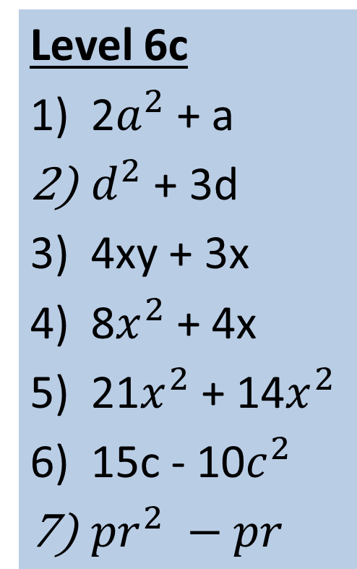
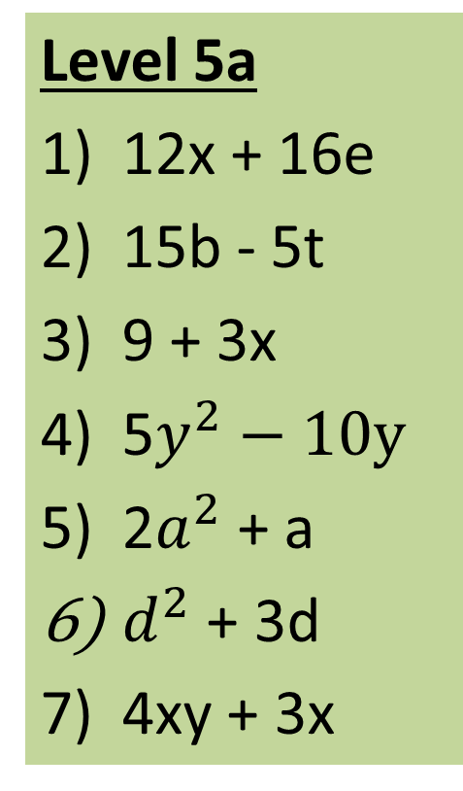
Activity 1 – Factorise the following:
Level 5b
2x + 6
4m + 12
16y + 10n
20p – 15r
15b – 5t
9 + 3x
12x + 16e
Level 5a
12x + 16e
15b - 5t
9 + 3x
5$y^{2}−10y$
2$a^{2}$ + a
$d^{2}$ + 3d
4xy + 3x
Level 6c
2$a^{2}$ + a
$d^{2}$ + 3d
4xy + 3x
8$x^{2}$ + 4x
21$x^{2}$ + 14$x^{2}$
15c - 10$c^{2}$
${pr}^{2} −pr$
10
9
8
6
5
3
2
1
7
4

Slide 14
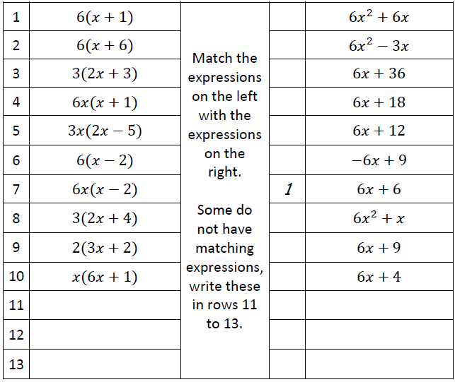

Slide 15
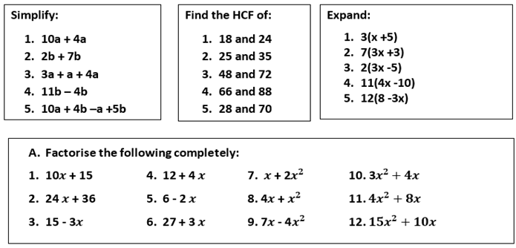
HW – Due Monday 3rd March

Slide 16
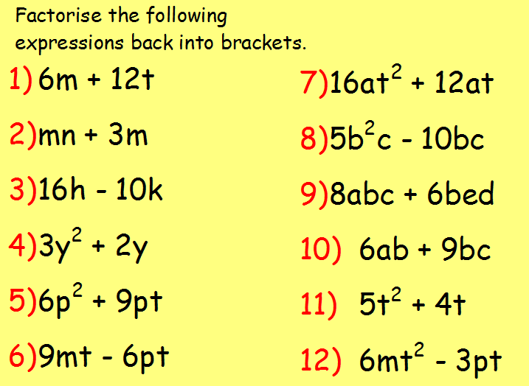

Slide 17
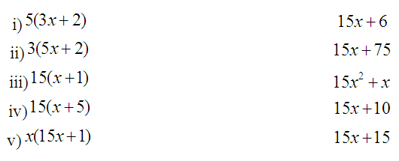
Factorising Expressions
Date: Friday 28th February 2014
LO: To be able to factorise expressions with numbers and letters into single brackets (Level 5a)
STARTER: Match the expansion to the factorised form (write down both in your books)…

Slide 18
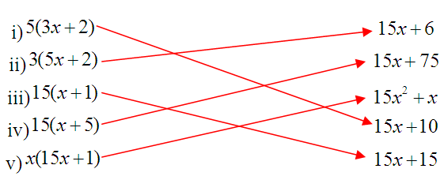

Slide 19
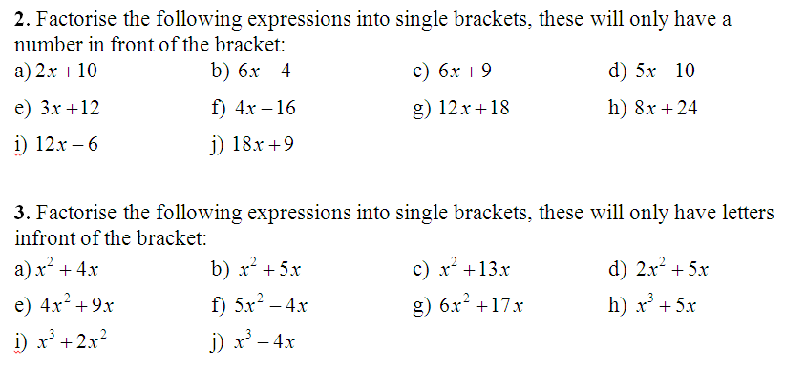
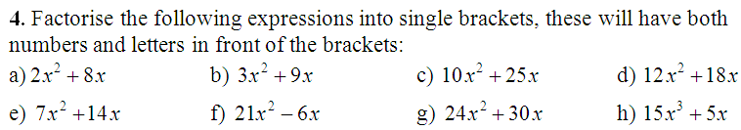
Activity 1
Extension:

Slide 20
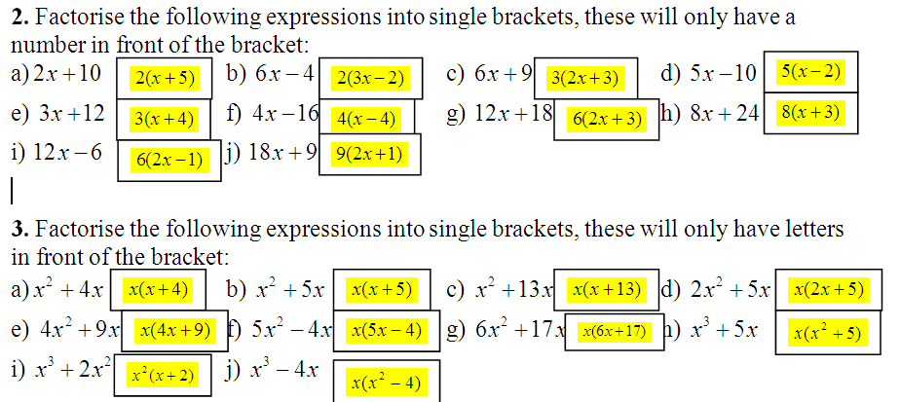
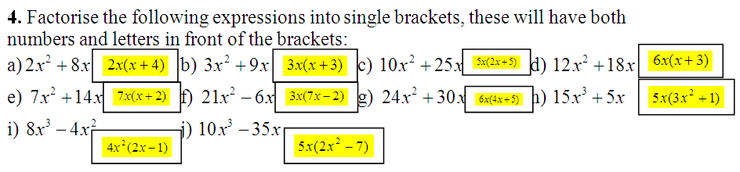
Answers to Activity 1

Slide 21
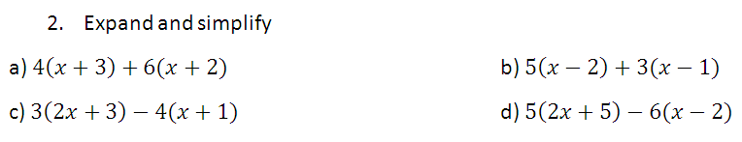
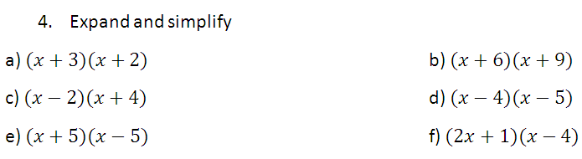
Plenary

